Slide 1
PORTER SAATHI
Empowering Driver-Partners Overcoming Literacy Barriers
Every Driver, Every Language and Every Day
Team Aurora

Slide 2
Contents
01
Understanding the Problem
02
Introducing the Solution: Porter Saathi
03
Key Features and Benefits
04
The Impact

Slide 3
Understanding the Problem

Slide 4
Literacy Barriers for Driver-Partners
01
App interactions
- Driver- partners often face difficulties in understanding written or spoken instructions, which can lead to misunderstandings and errors during communication with clients and the platform. - Inability to independently access insurance, contest challans, or use DigiLocker.
02
Impact on Daily Operations
- Literacy barriers can severely disrupt daily operations, resulting in delays, decreased efficiency, and a reduction in overall job satisfaction for driver- partners. - They often struggle to understand errors, penalties, or rewards.

Slide 5


Difficult App Use and Financial Access
Navigating Complex App Features
Many driver- partners struggle with navigating intricate app features, which can hinder their ability to effectively utilize the platform to manage their work and earnings.
Limited Access to Financial Services
Driver- partners may experience obstacles in accessing essential financial services, such as banking and payment options, making it challenging to manage their earnings effectively.

Slide 6
Introducing the Solution: Porter Saathi

Slide 7

A Voice-First AI Partner
Translating Complex Information
Facilitating Simple Conversations
Porter Saathi utilizes advanced natural language processing to break down complex data and terminology into easy- to- understand language, making it accessible for all users.
Designed for seamless interaction, Porter Saathi encourages engaging dialogue, allowing users to express themselves freely and receive thoughtful responses in return.

Slide 8
Key Features and Benefits
Simplified Business Conversations
Intuitive Safety and Life Skills Tutorials
With its user- friendly interface, Porter Saathi streamlines business discussions, reducing misunderstandings and enhancing productivity through clear and effective communication.
Porter Saathi offers practical tutorials focusing on safety measures and essential life skills, empowering users with knowledge and confidence to handle various situations effectively.

Slide 9
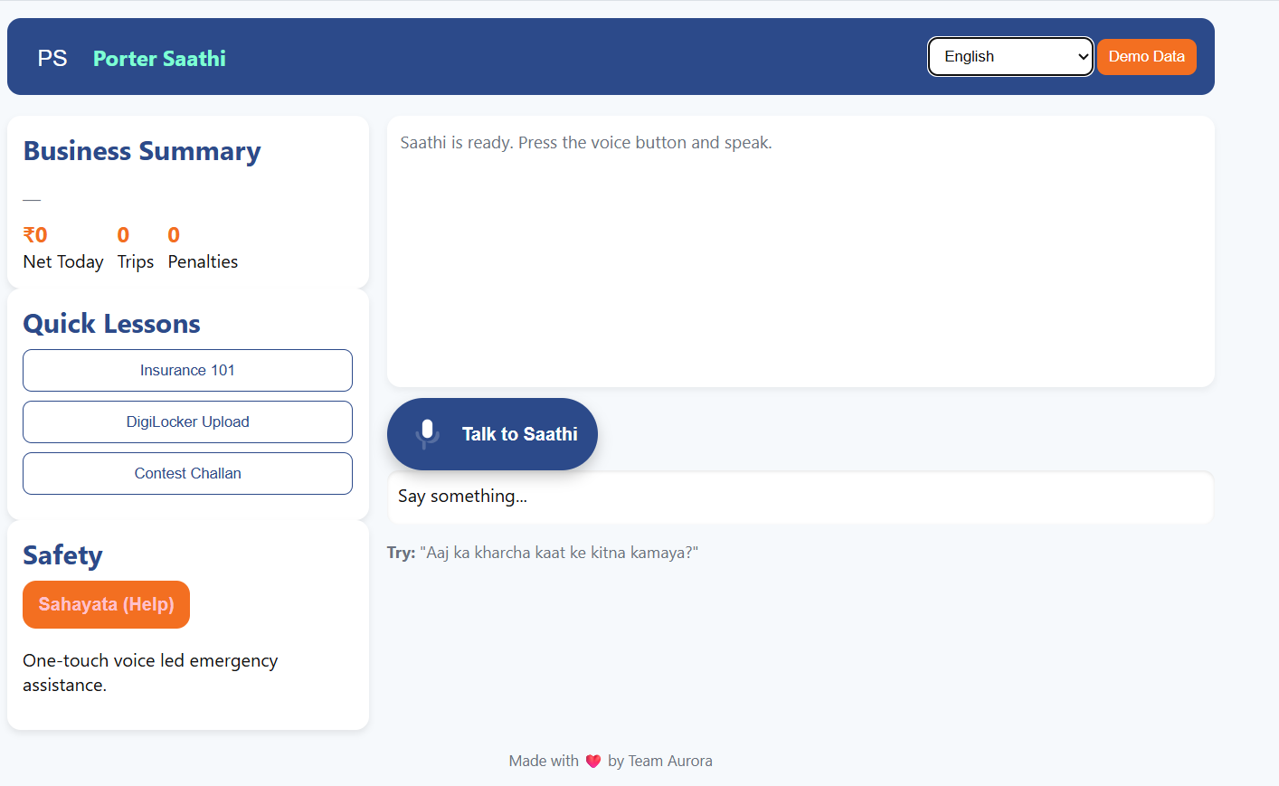
App UI

Slide 10
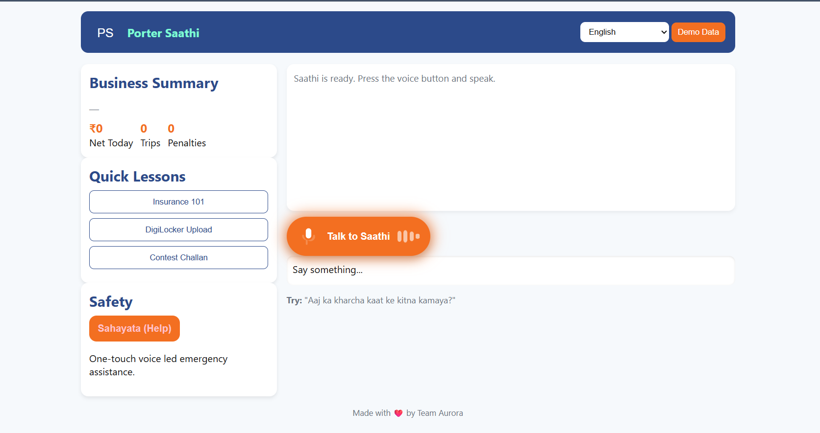
App UI

Slide 11
The Impact
- Independence: Drivers can manage business tasks without relying on others. - Confidence: Clear voice guidance reduces confusion and builds trust. - Growth: Access to financial insights, government services, and learning modules unlocks entrepreneurial potential. - Safety: Instant voice-first support ensures peace of mind on the road.

Slide 12
Thanks

